Slide 1
Workshop 6:
Sexual Violence & Abuser Tactics
The content was organized by the Women’s Initiative for Self Empowerment
www.womenofwise.org | 2021

Slide 2
Values we’ll stand by for these workshops
Respect each other’s point of view, even if it is different from yours.
Let’s listen to one another when they are sharing.
Let’s build each other up.
We are all in this together.
Let’s learn something new.
This is a safe and open space. What is said here stays here.

Slide 3
Icebreaker!
Let’s talk about our day.
(30 seconds)

Slide 4
How are we feeling?
Let’s do a meditation together ☺

Slide 5
Content may be triggering
Remember to take care of yourself
Message me privately or feel free to reach out to me if anything comes up

Slide 6

Video: Sexual Abuse is Confusing
Notes:
https://www.youtube.com/watch?v=Q4xwdFWjIOw

Slide 7
Question Quinn’s Story
Even though Quinn didn’t say no in the beginning, can she say no afterwards?
Why was it hard or confusing for Quinn to understand that she was being sexually abused?
Who could be an abuser?
Does it make it right and okay that the abuser bought her games after?
What should Quinn do if she wants this to stop?

Slide 8
Sexual Violence?
Refers to sexual activity when consent is not obtained or not freely given.
It includes attempts to obtain a sexual act, sexual harassment, coercion, trafficking for sexual exploitation, and female genital mutilation.

Slide 9
Why do people hurt others?
Emotionally, physically, verbally, and sexually
  It’s about wanting power and control
  Especially because they feel insecure, are unhealthy and need to feel more powerful than someone
  Does not give them the RIGHT to hurt anyone

Slide 10
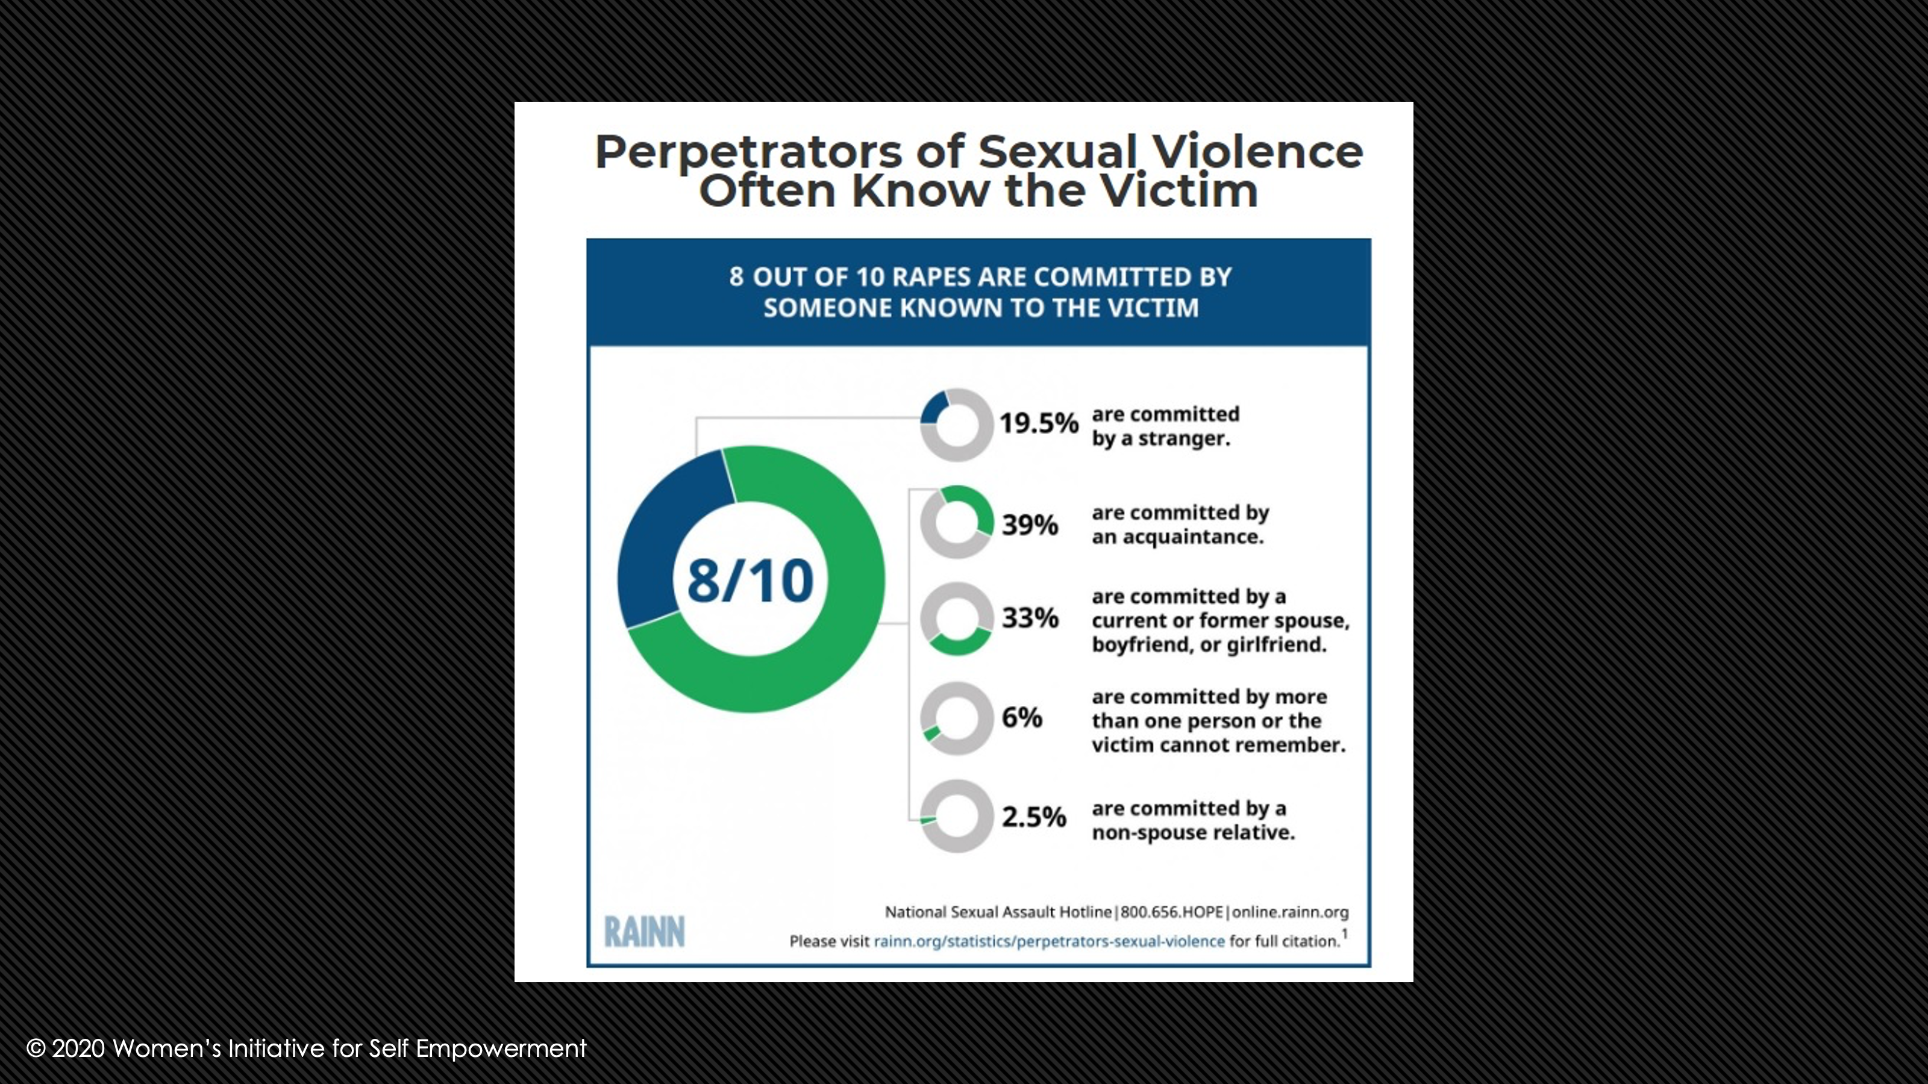
Perpetrators of Sexual Violence often know the victim
8 out of 10 rapes are committed by someone known to the victim.

Slide 11
Child Sexual Abuse
When SV involves a victim less than 18 years old, it is sexual abuse. Child sexual abuse (CSA) refers to the involvement of a child in sexual activity that he/she:
  Does not fully comprehend
  Does not consent to or it unable to give informed consent to
  Is not developmentally prepared for an cannot give consent to

Slide 12

Video: Sex without Consent is Rape
Notes:
https://www.youtube.com/watch?time_continue=2&v=04LeOdMEcRk&feature=emb_logo

Slide 13
Stats
Nearly half (48 percent) of bisexual women who are rape survivors experienced their first rape between ages 11 and 17.
About 1 in 4 male rape victims experienced it for the first time between 11-17 years old.
1 in 3 female rape victims experienced it for the first time between 11-17 years old.
Nearly 1 in 5 women have experienced completed or attempted rape during her lifetime.
A staggering 64% of transgender people have experienced sexual assault in their lifetime.
1 in 8 female rape victims reported that it occurred before age 10.
Nearly 1 in 38 men have experienced completed or attempted rape during his lifetime.

Slide 14
Tactics abusers use
Threats
  Harming someone you love or a pet
  Calling immigration on you or your family
  Showing video tapes of the abuse on the internet
  Spreading rumors at school or in the community

Slide 15
Power and Control Wheel: 8 ways abusers exert power and control
Notes:
8 ways abusers exert power and control:
Using Anger/Emotional Abuse, such as putting your partner down; making your partner feel bad about themselves; making your partner think they are crazy; name calling; playing mind games; humiliating one another; and making your partner feel guilty.
Using Social Status, such as treating your partner like a servant and acting mightier than the other.
Using intimidation, such as making someone afraid using looks, actions, words or displaying weapons.
By minimizing, denying or blaming the victim, such as shifting the blame, acting like abuse didn’t happen or blaming the other person for causing abuse to happen.
Using threats, such as threatening to hurt themselves or others, threatening to leave or make police reports.
Using sexual coercion, such as manipulating the other person for sex or getting the drunk or drugged in order to have sex.
Using isolation or exclusion, such as controlling what your partner does or who they talk to and justifying your actions through jealousy.
Using peer pressure, such as threatening to expose someone’s weakness or spread rumors about them; telling lies about your partner to other people.

Slide 16

Take a deep breath together

Slide 17
Look for 5 photos!
I’ll show you one of mine.

Slide 18
Photo 1

Slide 19
Photo 2

Slide 20
Photo 3

Slide 21
Photo 4

Slide 22
Photo 5

Slide 23
Contact

