Slide 1
w>rRvdzk. 3: w>&hvdmb.xGJvXt wtd.ql.td.cshwcgrh>rEkRvJ.
ydmrk>tw>ohw>b.vXeD>up>w>pdw>urDRt*D>
This content was organized by the Women’s Initiative for Self Empowerment
www.womenofwise.org | 2021

Slide 2
vk>yShRwz.vXyqXxX.cDzsdw>rRvdzk.wz.
ymuJvdmo;w*R'D;w*Rw>xH.<Ayw>xH.rh>w'H;od;vdmo;oemuhI
rf'due.vdmo;w*Rb.w*RzJ[h.cDeDRvDRtcgI
rfrRxDrRxDvdmoud;o;I
rfycJvXmvXw>tHRwylRCDylRI
rfrRvdM>w>toDwrHRrHR
rh>w>vD>vXtylRzsJ;'D;tD;xD.to;vXySRud;*Rt*D>IAw>vXw>wJtDRzJtHRtd.'.zJtHRvDRI

Slide 3
ySRrRvDRjyHxHck.ud.vd.w>[l;w>*JR
yuCkxXo;w>wl>b.cD.b.wcg’d;w>*h>wcg<A’D;w*Rpkmpkmub.wJxD.0JvXtuvk>z;’d.

Slide 4
Spin wheel Activity
rJ.qS;
rRoh.eD.
ySRt*kRt*RtJ.zDxJod;,tJ.td.{g?
o;wHmwm
vXySJR'D;w>o;ck
o;xD.
ysHRw
o;[;*DR
0H>w&H;!
ueD;
w>uX.
o;th*Hm
oD.oJwHmwm
ol.rk.o;ck.
tJ.b.
o;ck
urXur.
o.0HR
eJR(td.bSh.bSh.zd)
w>bSH;
ol.yd>o;0;
yD;,D;(wwkRvDR)

Slide 5
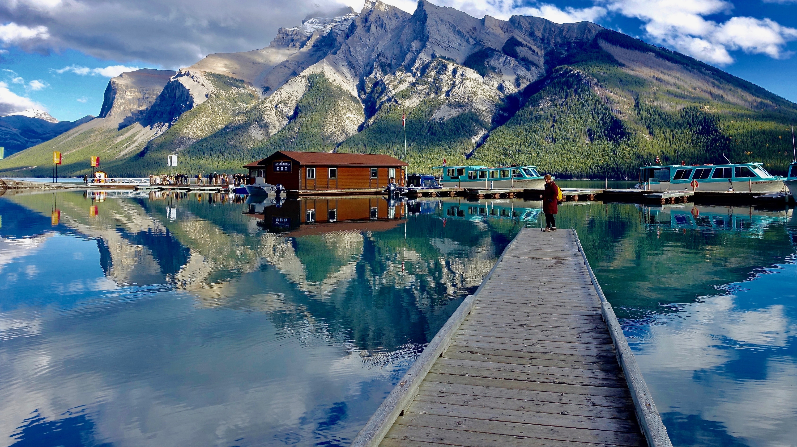
ywl>b.'fvJ.?
rRoud;w>uFh;w,gwcgwylRCD ☺

Slide 6
yuqdurd>
w>rEkRoh.wz.weDRvXw}uX;uJxD.vXw>&hvdmb.xGJtylR?
  w}uX;uJxD.eDwpJ;b.
  w}uX;uJxD.tgtgb.

Slide 7
tyeD.usdRusJwz.qlw>&hvdmb.xGJvXwtd.ql.td.cshb.
w>&hvdmb.xGJvXwtd.ql.td.cshtw.yeD.tcgA10
Notes:
https://www.joinonelove.org/signs-unhealthy-relationship/

Slide 8
1
ql.vXySJR
zJySRw*R*RvXymzsgxD.tw>wl>b.'d.'d.rk>rk>'D;td.vXw>ouJ;y0;tzDcd.vXwl>b.b.ud>b.*DRwvX

Slide 9
2
ohb.vXySJRvXySR*RzDcd.
zJySRw*R*R*kmusJ;pX;cD.}xdew>qXwJmwz.<Aw>[l;w>*JRwz.<Arhwrh>o;w>wl>b.wz.I

Slide 10
3
rR[;*km[;*DR
zJySRw*R*RynD.rR[;*DRew>xH.w>em<Aw>uJxD.uJuJxDwz.<Arhwrh>w>rReXR

Slide 11
4
qD.bH.qD.bXvXuJxD.ew>ur.
zJySRw*R*RrReRvXewl>b.vXrl'gtd.vXt0Joh. tw>[l;w>*JRwz.t*D>rhwrh>rReRvXewl>b.vXeb.o;w>tHRrh>ew>rRvXuymt0Joh.o;zSH

Slide 12
5
w>uJxD.[J'db.uhRrl'g
zJySRw*R*RrR0hRrR0DRto;vXtw>ouJ;y0;wtd.ql.td.cshCdySRb.e>yX>tDR

Slide 13
6
rR[;*DRySR*Rtw>b.ol.b.o;
zJySRw*R*Ro;uh.vXt0Joh.*kmusJ;pX;cD.}xdeRvXeolw>qXuwD>'D;rwR'D;erRrEkR

Slide 14
7
ysJtd.w*R
zJySRw*R*Rym,HReR'D;ewHRoud;wz.<A[H.zdCDzd<Arhwrh>ySRt*Rwz.

Slide 15
8
rRtDRvXwrh>t&h'd.b.
zJySRw*R*RrR'D;wJw>wrHRrHRvXurRewl>b.w*hR
wb.b.C;eeD>up>

Slide 16
9
w>rRwysKmwysDRvXwqdurd>
zJySRw*R*Rtd.'D;w>*H>ql.eD>eD.<Aw>[l;w>*JRwz.vXeqdurd.w,mwohb.vXrRewl>b.ysHRw><Ao;wHmwm<Arhwrh>vDRysHRvDRzk;

Slide 17
10
w>rR[;*DRw>em
zJySRw*R*Rrh>ySRwwDb.rhwrh>[l;*JRvXw>ynd.zDcd.vXw>wwDwvdRtusJ

Slide 18
wtdRchRvXew>wl>b.wz.ub.'db.xH;b.
ySRw>cGJ;w>,mwtd.eDw*RvXurXeRvXeuwl> b. w>oh. wz.tHRb.
zJySRw*R*RyH'HvXezDcd.wue.CkmeRvXw>8h>wtd.eDwrHRw>tHRtcDy nD t0Joh.o;xD.w>vXteD>up>.
w>wl>b.rwRoh.wz.weDRvXb.oh.oh.euwl>b.zJ w>oh.wz.uJxD.tcgvJ.?

Slide 19
tuwX>cD.xH; 3?
euwJrEkRvJ.vXw>yeD.A3cgvXewb.o;t'd.uwX>vXew>&hvdmb.xGJtylR<Ab.rEkRtCDvJ.?
erhwl>b.vXol.uvXRo;uvXRvXySJR<A[J'db.uhRew>&hvdmb.xGJwz.'D;w>rEkRweDRvXevJRcDzsdwh>tDRvJ.

Slide 20
yuuG>w>td.o;wz.

Slide 21
w>td.o; #1
rJ.&H.EkmvDRb.vXw>&hvdmb.xGJtoD'D; &R[hrfIAt0Joh.td.vXwDRxDuFdtqXuwD>IAt0Joh. tJ.vdmo;td.A5vgcJtHR<'D;rJ.&H.tJ.'D; 0J&R[hrft(zh.bd;)tw>clol.IArJ.&H.wJ&R[hrfrhwwJw>'D;ySRydmrk.eDw*RM>wvd>vX&R[hrfud>w>b.rJ.&H.rhwJ'D;ySR*Ro emuh.
w>yeD.rEkRvXrJ.&H.ymzsgvJ.?
usJvXttd.*H>td.bgwbdvX&R[hrfub.wkRCDRM>rh>usJrwRvJ.?
rJ.&H.rhw'due.wcDrD.?

Slide 22
w>td.o; #2
vgeHRrh>wHRoud;wH>eD>'D;qXvhvX>IAvgeHRwJqXvhvX>vXt0Jwb.o;0JwHRoud;t*Rw*RuFhrH.b.<Arh>vXuFhrH.xDbdrRvgeHRwl>b. uhRb.C; teD>up>tXw*hRb.IAwEGH0HRtvD>cHvgeHRoh.ngvXqXvhvX>wJb.uFhrH.IAzJvgeHRvJRbl;'D;uFhrH.=uFhrH.wJtDRvXwrh.tw>ur.vXtwJtDR'fM> b..
qXvhvX>ymzsgw>yeD.rEkRvJ.?
vgeHRub.rRrEkRvXw>td.o;tHRtzDcd.vJ.?

Slide 23
w>td.o; #3
rHchvR'Doud;'D;rhxH.IArhchvRqD.oeH;rhxH.vXuvD0JrHchvRtrdtygvXrHchvRtd.vXrhxH.t [H.zJrHchvRvJR[;yFD.yGJtzXIArhxH.wtJ.'D;wJ b.IArHchvRwJ0JvXrhxH.rhwrRvXt*D>b.MR<At0Joh.wuJwHRoud;vXRb.I
w>yeD.rEkRvXrHchvRymzsgvJ.
rhxH.}uX;rRrEkRvJ.?

Slide 24
yuuGJ;u'D;w>vXt}uX;vXt*hRrRrk.ySRtoDwcg
ymvDRew>*DRvXt*hRwbh.'D;erHR
vJRvX(uluX.)tvHmylR'D;uGJ;w>wrHRrHRvXt*hRvXtb.Cgw*Rqlw*R

Slide 25
qJ;uG>Ckew>*DRA5bh.!

Slide 26
Contact

